Slide 1

Department of Information Technology Atharva College of Engineering Mumbai.
Educational App using Augmented Reality
Presented By
Natasha Ambre
Arpita Bhagat
Ninad Chavan
Guided By
Prof. Samira Nigrel

Slide 2
Index
Abstract
Introduction
Aims and Objectives
Literature Survey
Problem Statement
Scope Of Project
Block Diagram
Details of Hardware & Software
References

Slide 3
Abstract
This app will be using augmented reality to implement detailed concept of plants. The concept will be explained with the help of a story that will be narrated by a character. All the while involving the user with a few multiple choice questions to choose from that the character can ask the plant. The plant will answer the asked question thereby keeping the user engaged. Further more concepts will be added in as the project progresses.

Slide 4
Introduction
Cellphones being an integral part of our lives play a very important role in the development of a child’s intellect. An average child spends around an hour using mobile devices everyday. To put to constructive use this time this app explains educational concepts using augmented reality in a two way learning format. Through this app children will be able to understand concepts easier, ask questions i.e interactive approach and retain the information obtained for longer durations as their visual memory is targeted creating an experience for them.

Slide 5
Aims and objectives
Aim: To implement an interactive educational app using augmented reality for age group 5-15.
Objectives
To develop interests of students in learning
To explain a concept innovatively in the form of a story
To address questions of the users for a better learning experience
To interact with the user so as to ensure his/her understanding of the concept.
To exploit the visual memory of humans in order to manipulate their interests

Slide 6
Literature Survey
Sr. No | Title | Author | Publication | Approach
1. | Scalable 360° Video Stream Delivery: Challenges, Solutions, and Opportunities | Michael Zink Ramesh Sitaraman Klara Nahrstedt | IEEE 2019 | Approaches of creating, distributing, and presenting 360° video content, including 360° video recording, storage, distribution, edge delivery, and quality-of-experience evaluation
2. | Mosaicing a Wide Geometric Field of View for Effective Interaction in Augmented Reality | Seokhee Jeon , Gerard J. Kim | IEEE 2009 | Increasing the geometric field of view can be tolerated to some degree without much degradation in task performance
3. | Evaluation of labelling layout methods in augmented reality | Gang Li Yue Liu Yongtian Wang | IEEE 2017 | Without the requirements of setting rules and constraints for occlusion among the labels, the results of three search space methods are evaluated by using objective analysis of related parameters

Slide 7
Problem Statement
Generating interests in education has become a challenge due to the traditional methods. Using AR in education will target users’ visual memory thereby ensuring increased interest in learning.
Scope of Project
Children will be able to study concepts through stories in which a character and the elements of the concept (For Eg. A plant) will interact with each other thereby explaining the concept.

Slide 8
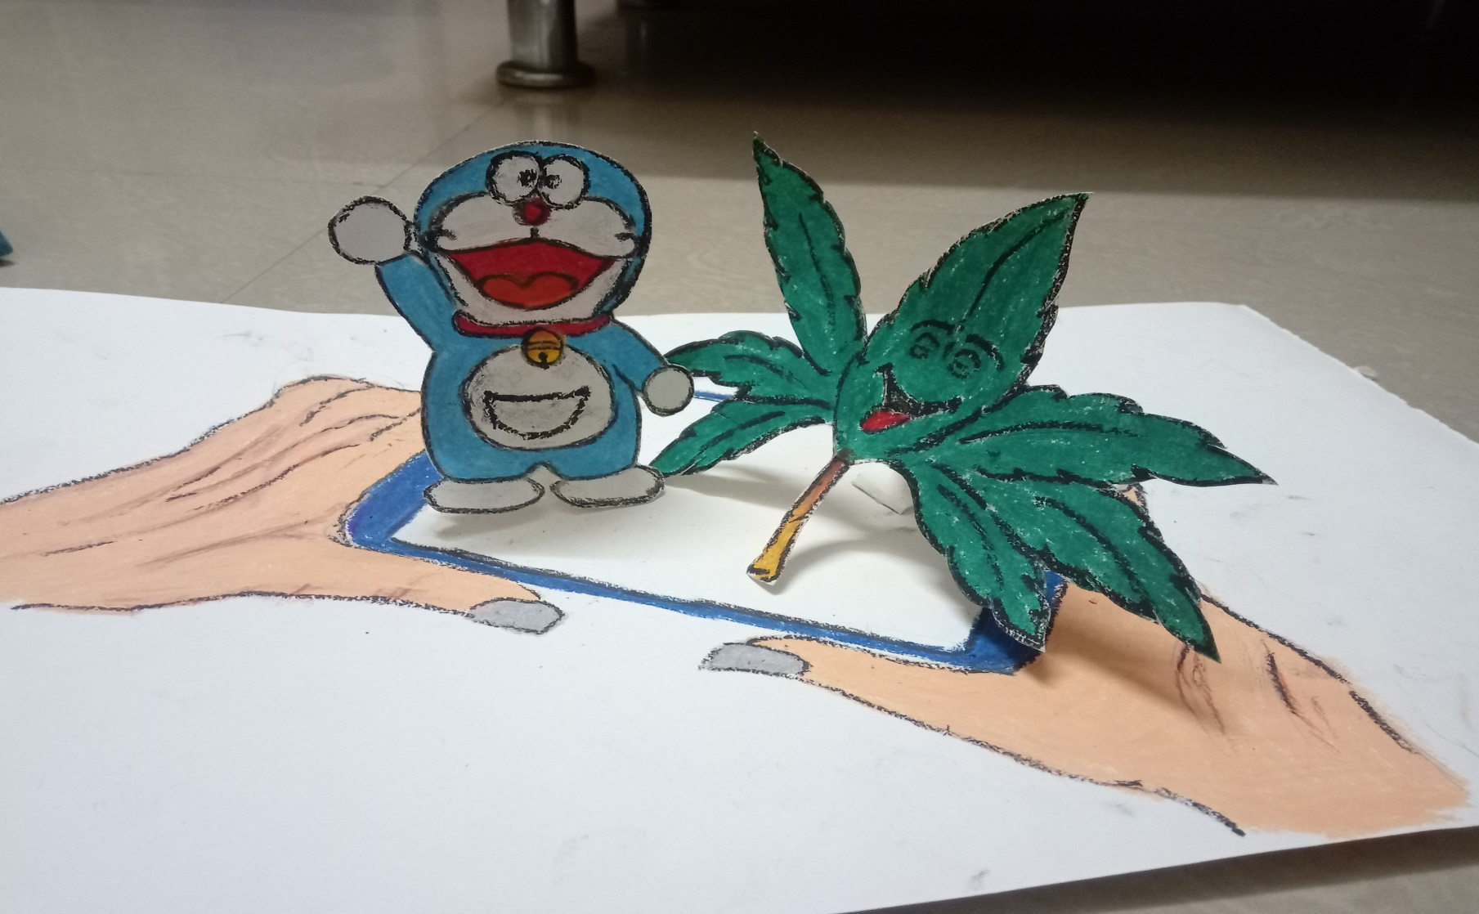
Prototype

Slide 9

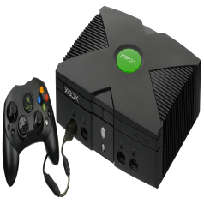

Block Diagram
Stories
Games
Themes
Phase 1
Phase 2
Phase 3

Slide 10
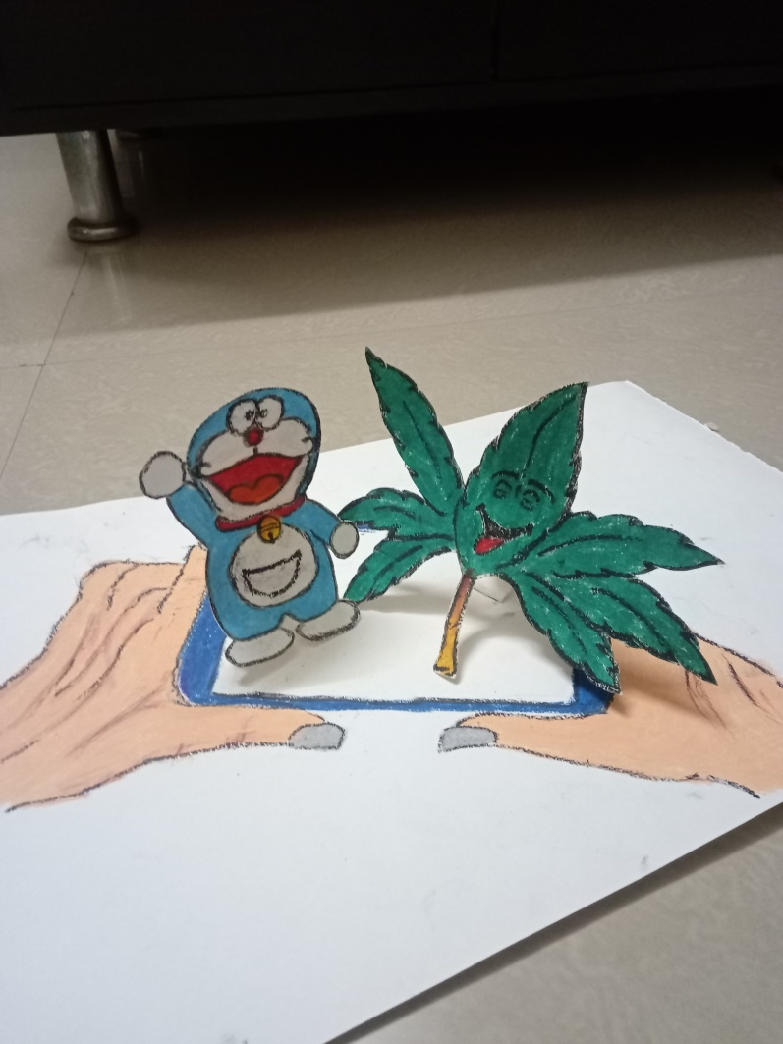
Conclusion
This app will put to constructive use the time spent by children on mobile devices. It will also retain the interests of the user and keep them engaged with the lesson.

Slide 11
Details of Software and Hardware
Software
Unity
Blender
Android SDK.
Vuforia Unity Extension
Java JRE
Hardware
The system will work on mobile devices, tablets, and AR compatible devices.

Slide 12
References
Gang Li, Yue Liu, Yongtian Wang., “Evaluation of labeling layout methods in augmented reality” 2017 IEEE Virtual Reality (VR)
Michael Zink ; Ramesh Sitaraman ; Klara Nahrstedt., ”Scalable 360° Video Stream Delivery: Challenges, Solutions, and Opportunities” Proceedings of the IEEE
Crystian Wendel M. Leão, João Paulo Lima , Veronica Teichrieb , Eduardo S. Albuquerque, Judith Kelner., “Altered reality: Augmenting and diminishing reality in real time” 2011 IEEE Virtual Reality Conference
Taiki Fukiage, Takahiro Kawabe, Shin’ya Nishida., “Perceptually Based Adaptive Motion Retargeting to Animate Real Objects by Light Projection” IEEE Transactions on Visualization and Computer Graphics
Andrew Roth .,“The Arlab and Cave libraries: On authoring augmented reality and virtual reality experiences using a graphical programming language” 2011 IEEE International Symposium on Mixed and Augmented Reality - Arts, Media, and Humanities

